Slide 1
Patent Drafting
Dr Nagender Aneja
Universiti Brunei Darussalam

Slide 2
Parts of Patent Application
Drawings
Specification
Title
Cross-reference to related Application
Background
Summary
List of Drawings
Detailed Description
Claims
Abstract

Slide 3
Patent Application Form
Inventor
Anyone who contributed in at least one claim in the patent
Assignee or Applicant
Who owns the Patent, can be Individual or Business Entity
Filing Date
Priority Date
Must file either a first local application or get permission form local patent office to file first international application

Slide 4
Example Inventions

Slide 5
Table Identification using Neural Network

Slide 6
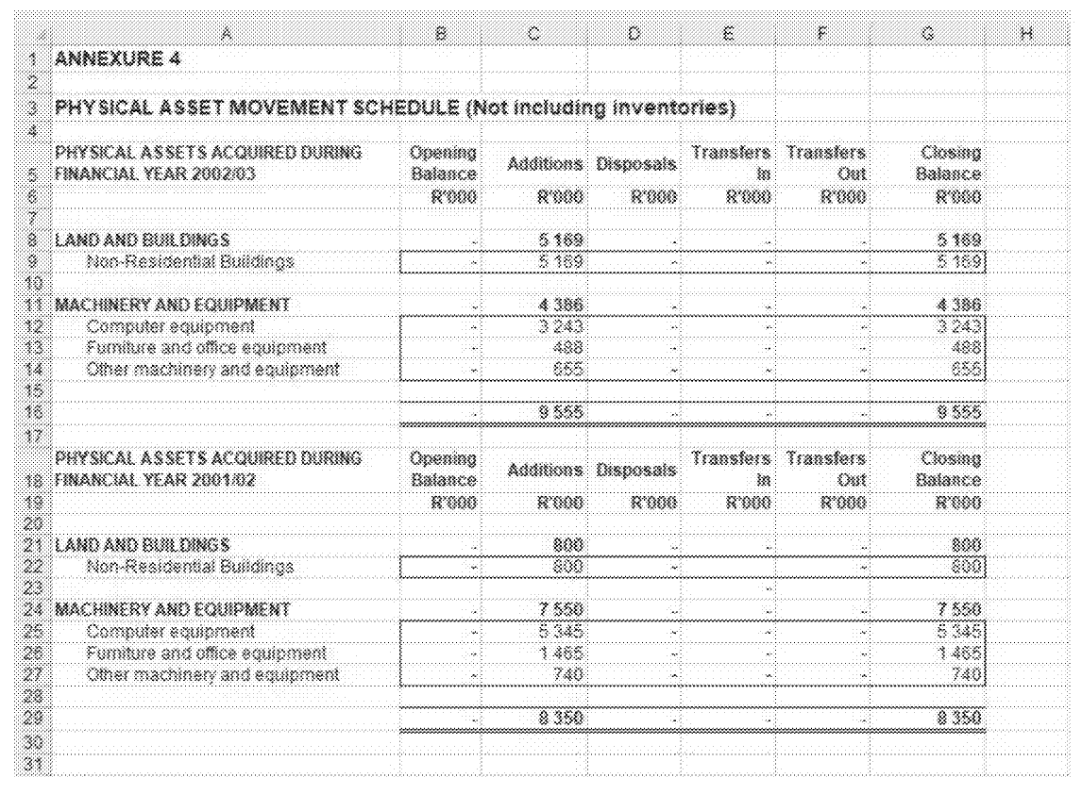
Problem

Slide 7
Table Identification in a Spreadsheet
Apply CNN on a rectangular context surrounding a cell to classify the cell as a potential corner
Combine the corner prediction according to graphical model to identify the table

Slide 8
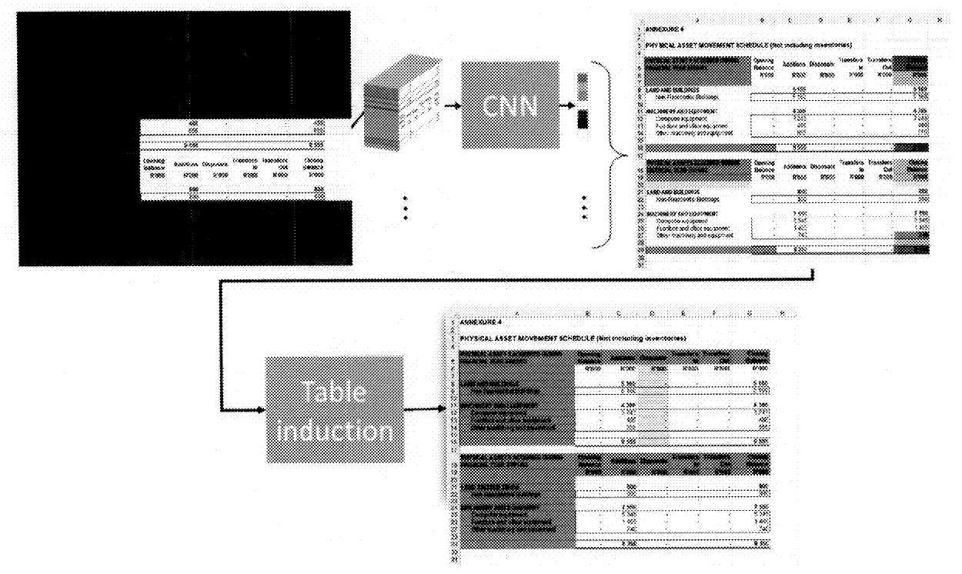
Solution

Slide 9
Patent Application Parts
Title
SYSTEMS, METHODS, AND COMPUTER-READABLE MEDIA FOR IMPROVED TABLE IDENTIFICATION USING A NEURAL NETWORK
Drawings
Fig 1 and Fig 2

Slide 10
Specification
Technical Area
The present disclosure relates to table identification in a spreadsheet.
Specifically, the present disclosure relates to improved table identification in a spreadsheet using a neural network.
Introduction
A spreadsheet ..
There is a problem of …
The invention solves … and can also be used …

Slide 11
Summary
A method of …… is disclosed, according to method, ….
A system for …. is disclosed, comprising a processor to execute instructions …
A computer readable storage media storing instructions for ….

Slide 12
Brief Description of Drawings
FIG. 1 depicts a spreadsheet having two vertically-aligned tables
FIG. 2 depicts overview of a table identification decomposed into corner identification and table induction

Slide 13
Detailed Description
…
FIG. 1 depicts … As shown in FIG. 1, …
FIG. 2 depicts … As shown in FIG. 2, …
…

Slide 14
Claim
Input
a spreadsheet with a table
Processing
identify class of each cell of spreadsheet whether it is a corner or not-a-corner
Output
inducing table based on identified classes for each cell

Slide 15
Claims
Independent Claim
1. A method of …
Dependent Claim
2. The method according to Claim 1, wherein
3. The method according to Claim 1, further comprising …

Slide 16
Form of Claims
Each claim must be a single sentence
Must begin with a capital letter and end with a period.
Since there is one sentence, thus comma and semi colons are used frequently

Slide 17
Form of Claims
Arrange Claims in order of scope
Patent Groups of Method Claim, System Claim, Computer Readable Media Claim
Within Group
First claim is the Independent claim - Broadest claim (least restrictive)
Other claims are dependent claims - add restrictions to broadest claims

Slide 18
Example Patent Claim
Preamble and transitional phrase | A method of …, the method comprising:
Element 1 | receiving input …
Element 2 | processing ..
Element 3 | giving output …

Slide 19
Claim Infringement
Claim Elements | Infringer 1 | Infringer 2 | Infringer 3 | Infringer 4 | Infringer 5
A | X | X | - | X | X
B | X | X | X | - | X
C | X | - | X | X | X
 |  |  |  |  | X

Slide 20
Claims must be definite
First time we introduce a limitation (i.e., an element, characteristic, internal reference, etc.)
MUST introduce it with either “a” or “an”, as is grammatically appropriate. (i.e., Primary antecedent basis).
Subsequently we refer to the already introduced limitation by either “said” or “the.” (i.e., Secondary antecedent basis)

Slide 21
Claims must be definite
A computer comprising:
a memory; and
a processor.
The computer of claim 1, further comprising:
a display.
The computer of claim 1, wherein the memory is a RAM.
This claim reads on
Embedded System with microcontroller and ROM
Desktop Computer
A car including a navigation system

Slide 22
UI Claims
UI can be protected:
Utility Patent for the function
Design Patent for the ornamental design
Copyright protection for the non-functional elements

Slide 23
UI Claims
A system comprising:
a memory; and
a server module stored on the memory and configured to: ...
A system comprising:
a memory; and
a client module stored on the memory and configured to: ...

Slide 24
UI Claim
A method, comprising:
animating execution of a code module configured to
…

Slide 25
Claims
Claims must be drawn to a single invention:
Client
Server
UI

Slide 26
Claim Strategy
Start by drafting the method claim
include steps that are novel
System and Computer Readable Media claim is easy after method claim
Dependent claims:
Claim differentiation
Additional points of novelty

Slide 27
Tying claim to machine
A method for adding numbers, comprising:
receiving a first and second value; and
determining a third value that is the sum of the first and second values.
A method for adding numbers, comprising:
in a computer, receiving a first and second value; and
determining a third value that is the sum of the first and second values.

Slide 28
Claim - Table Identification
A method for improved table identification in a spreadsheet, the method comprising:
receiving a spreadsheet including at least one table;
identifying, using machine learning, one or more classes of a plurality of classes for each cell of the received spreadsheet,
wherein the plurality of classes include corners and not-a-corner; and
inducing at least one table in the received spreadsheet based on the one or more identified classes for each cell of the received spreadsheet.

Slide 29
Claims
The method according to claim 1, wherein the plurality of classes include a top-left corner, a top-right corner, a bottom-left corner, a bottom-right corner, a header bottom-left corner, a header bottom-right corner, and not-a-corner.

Slide 30
Claims
The method according to claim 1, further comprising: applying at least one regularization technique to the annotated dataset.

Slide 31
SYSTEMS, METHODS, AND COMPUTER-READABLE MEDIA FOR IMPROVED TABLE IDENTIFICATION USING A NEURAL NETWORK
http://appft.uspto.gov/netacgi/nph-Parser?Sect1=PTO1&Sect2=HITOFF&d=PG01&p=1&u=%2Fnetahtml%2FPTO%2Fsrchnum.html&r=1&f=G&l=50&s1=%2220200019603%22.PGNR.&OS=DN/20200019603&RS=DN/20200019603

